Slide 1
HealTouch
B Ayshwarya, C B Ananya, S Vaishnavi
SSN College of Engineering
SDG GOAL 3:GOOD HEALTH AND WELL BEING

Slide 2
PROBLEM STATEMENT
- Current integration methods for non-invasive therapies like physiotherapy and acupressure lack accuracy, personalization, and standardized techniques.
- Difficulty in accurately identifying and stimulating specific acupressure points and meridian lines compromises therapy effectiveness.
- Physiotherapy patients with mobility limitations struggle to attend sessions and require supervision for effective exercise execution.

Slide 3
PROBLEM STATEMENT
- Technical challenges, such as locating pressure points, hinder acupressure's popularity and efficacy in self-administration.
- The project aims to address these challenges by offering precise guidance, personalized routines, and enhanced accessibility through innovative solutions.

Slide 4
MOTIVATION
Safe side-effect free and Non-Invasive Therapy: By prioritizing side-effect-free methods and avoiding invasive medicines, this approach ensures that users can engage in self-care confidently, without the worry of adverse reactions or discomfort.
Accessible Healthcare: HealTouch democratizes access to effective physiotherapy by providing users with personalized routines they can perform at home. This reduces the burden on healthcare systems and makes therapy more accessible to those with mobility limitations or in remote areas.
Empowerment Through Education: By offering comprehensive educational content, our solution empowers users to take control of their health and well-being. This knowledge not only enhances their own self-care practices but can also be shared within their communities, promoting health literacy and awareness.

Slide 5
MOTIVATION
Reduced Healthcare Costs: With improved self-care practices and better treatment outcomes, users of HealTouch may experience fewer healthcare visits and reduced reliance on medication or more invasive interventions. This can lead to long-term cost savings for individuals and healthcare systems alike.
Community Support and Connection: Our solution fosters a supportive community where users can share their experiences, insights, and encouragement. This sense of connection and solidarity can have profound positive effects on mental health and well-being, combating social isolation and loneliness.
Overall, our solution not only enhances individual health outcomes but also contributes to a more equitable, empowered, and connected society.

Slide 6
Project objective
To create a web application that assists physiotherapy, acupressure and other self-care oriented healing methodologies.
To help users move towards side-effect free, non-invasive medications such as acupressure
To build 3D models of human body parts with acupressure points and meridian lines imbibed in them leading to easy identification for users

Slide 7
Project objective
To implement symptom-based analysis with the help of a chatbot trained on authorized datasets.
To implement a real-time exercise detection system that provides real-time feedback to patients based on their proximity to expected posture/exercises.
To provide a community platform were queries can be resolved by members

Slide 8
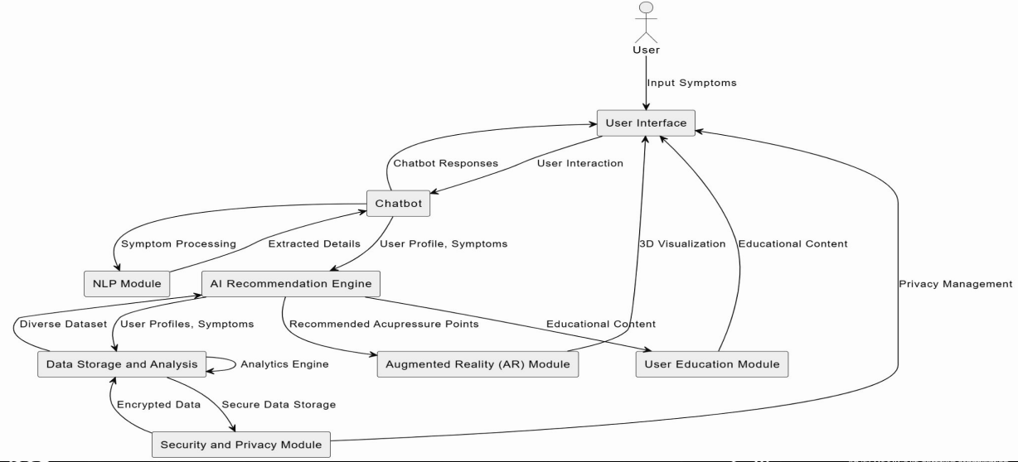
PROPOSED SYSTEM DESIGN

Slide 9
UNIQUE SELLING POINT
- By leveraging
3d models
Chatbot-driven symptom analysis, and
Real-time exercise detection, the project seeks to revolutionize the integration of physiotherapy and acupressure into daily healthcare practices.

Slide 10
EXISTING SYSTEM
Physiotherapy Apps:
Several mobile apps offer physiotherapy exercise routines and instructions. Some may incorporate video demonstrations, but lack real-time feedback on posture or movement accuracy.
Acupressure Apps:
Apps exist that provide acupressure point location guides and basic instructions. However, they lack personalized recommendations or 3d model features for visualization.
Chatbots for Symptom Analysis:
Some healthcare providers utilize chatbots for basic symptom analysis and triage. These are generally not designed for personalized treatment plans.
Some of the Limitations of Existing Solutions:
Limited Personalization: Existing solutions often offer generic plans, lacking the in-depth assessment and personalization you propose.
Feedback and Accuracy: Real-time feedback on posture and movement accuracy is rare in current apps.

Slide 11
TARGET MARKET
Psychographic Segmentation:
❏ Lifestyle: Health-conscious individuals seeking holistic wellness.
❏ Attitudes: Open to alternative medicine and self-care practices.
❏ Values: Prioritize mental and physical well-being.
Behavioral Segmentation:
❏ Usage Patterns: Individuals currently practicing or interested in starting acupressure routines at home.
❏ Benefits Sought: Those looking for personalized, evidence-based acupressure guidance.
User Skill Level:
Novice to Intermediate: Individuals with varying levels of familiarity with acupressure, from beginners to those with some experience.
Health Conditions:
❏ General Wellness Seekers: Users looking to improve overall health and well-being through self-care practices.
❏ Stress Management: Individuals experiencing stress-related issues seeking natural solutions.

Slide 12
METHODOLOGY
Interactive Chatbot Engagement for Differential Diagnosis:
○ Integrates DeepAI for building an intelligent chatbot that engages users in sophisticated dialogues.
○ Utilizes TensorFlow for implementing natural language processing (NLP) techniques to extract detailed symptomatology.
○ Implements Spinbot for article rewriting to ensure nuanced and personalized therapeutic plans, akin to a medical differential diagnosis.
○ Trains the chatbot primarily on authorized acupressure and physiotherapy handbooks as knowledge base and be able to generate authentic text, image and video response.

Slide 13
METHODOLOGY
Automated Real-Time Posture and Exercise Movement Detection for Physiotherapy:
○ Utilizes OpenCV module for real-time posture and exercise movement detection during physiotherapy sessions.
○ Integrates TensorFlow for machine learning to classify correct posture maintenance and exercise movements in real-time.

Slide 14
REFERENCES
[1] Kale, Sunil & Kulkarni, Nipun & Kumbhkarn, Sumit & Khuspe, Atharva & Kharde, Shreyash. (2023). Posture Detection and Comparison of Different Physical Exercises Based on Deep Learning Using Media Pipe, Opencv. 07. 29.
https://www.researchgate.net/publication/369927493_Posture_Detection_and_Comparison_of_Different_Physi cal_Exercises_Based_on_Deep_Learning_Using_Media_Pipe_Opencv
[2] Acupressure Ebook
https://www.scribd.com/document/129893734/Acupressure-eBook
[3] Physiotherapy Handbook 2023, Ministry of Health and Family Welfare
https://main.mohfw.gov.in/sites/default/files/PHYSIOTHERAPY%20HANDBOOK%202023-2.pdf

